Slide 1


The SOLID Principles
2022

Slide 2

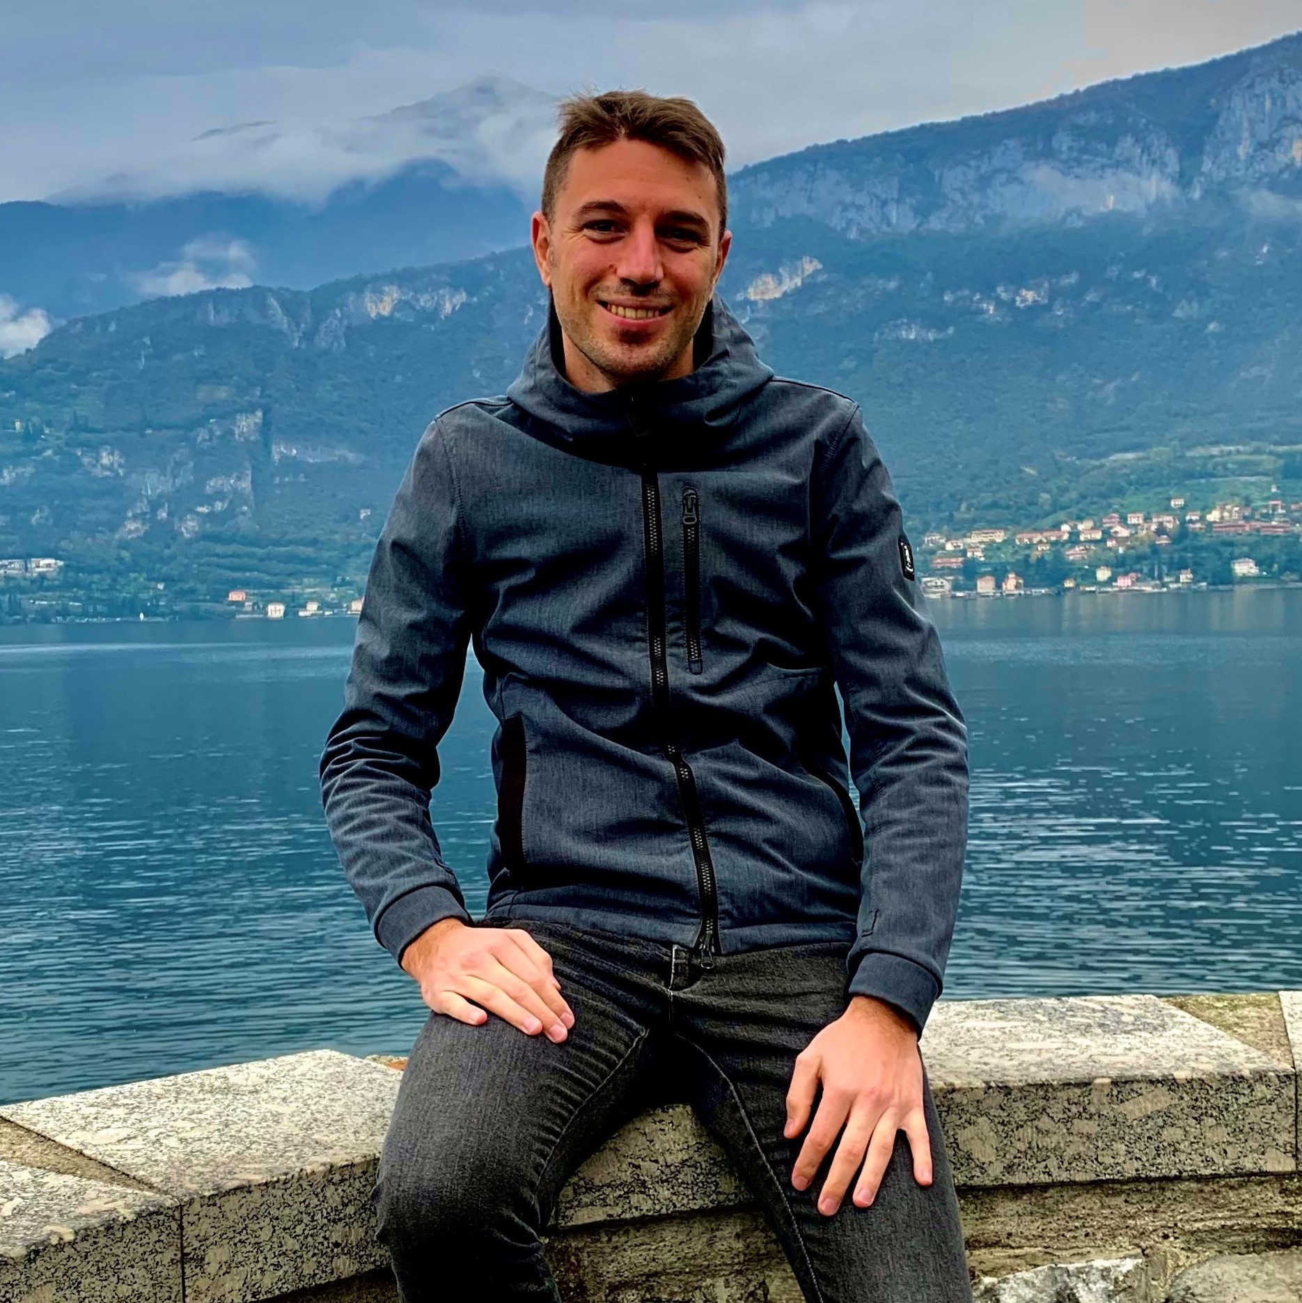
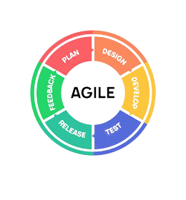
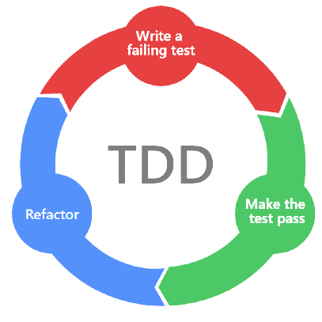

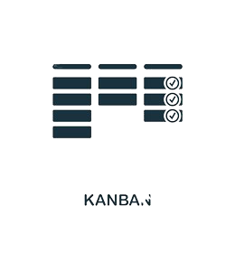

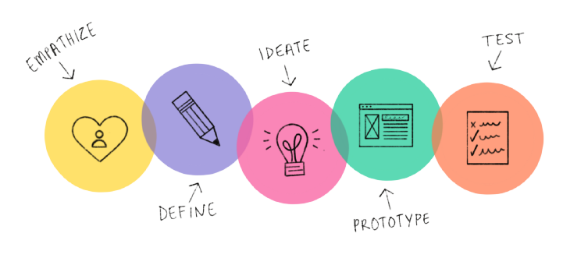
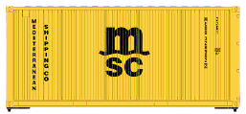
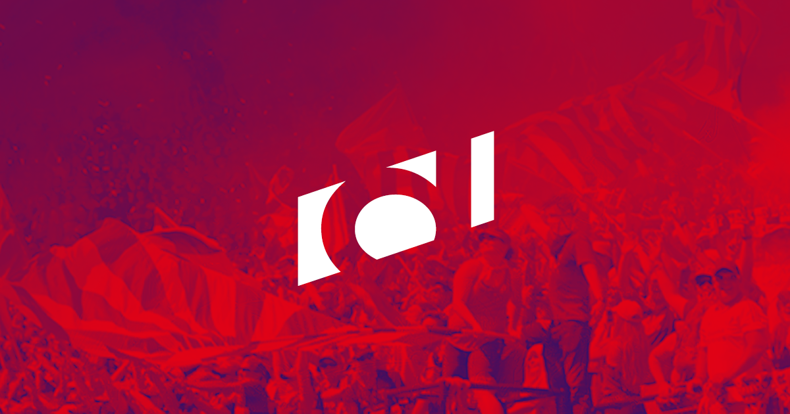







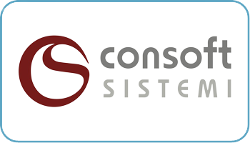



Luca Legora
Luca Legora
Agile Coach @ MSC Technology Italia
Agile Coach
MSC Mediterranean Shipping Company
Dec 2021 – Present
Product Owner
Deltatre
Feb 2020 – Nov 2021
Scrum Master
Apr 2018 – Jan 2020
Full-Stack Developer
Apr 2016 – Mar 2018
.NET Developer
Consoft Sistemi
Mar 2014 – Apr 2016
Bachelor of Computer Science – Computer Engineering
Politecnico di Torino
Oct 2013

Slide 3


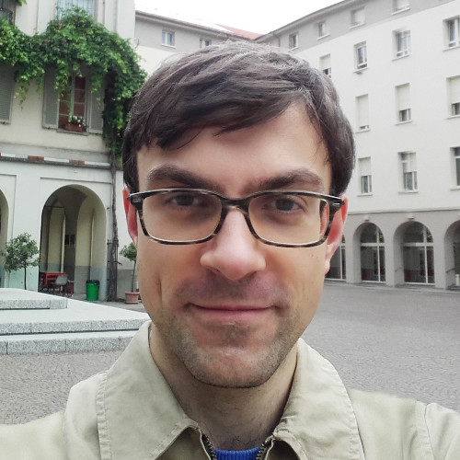


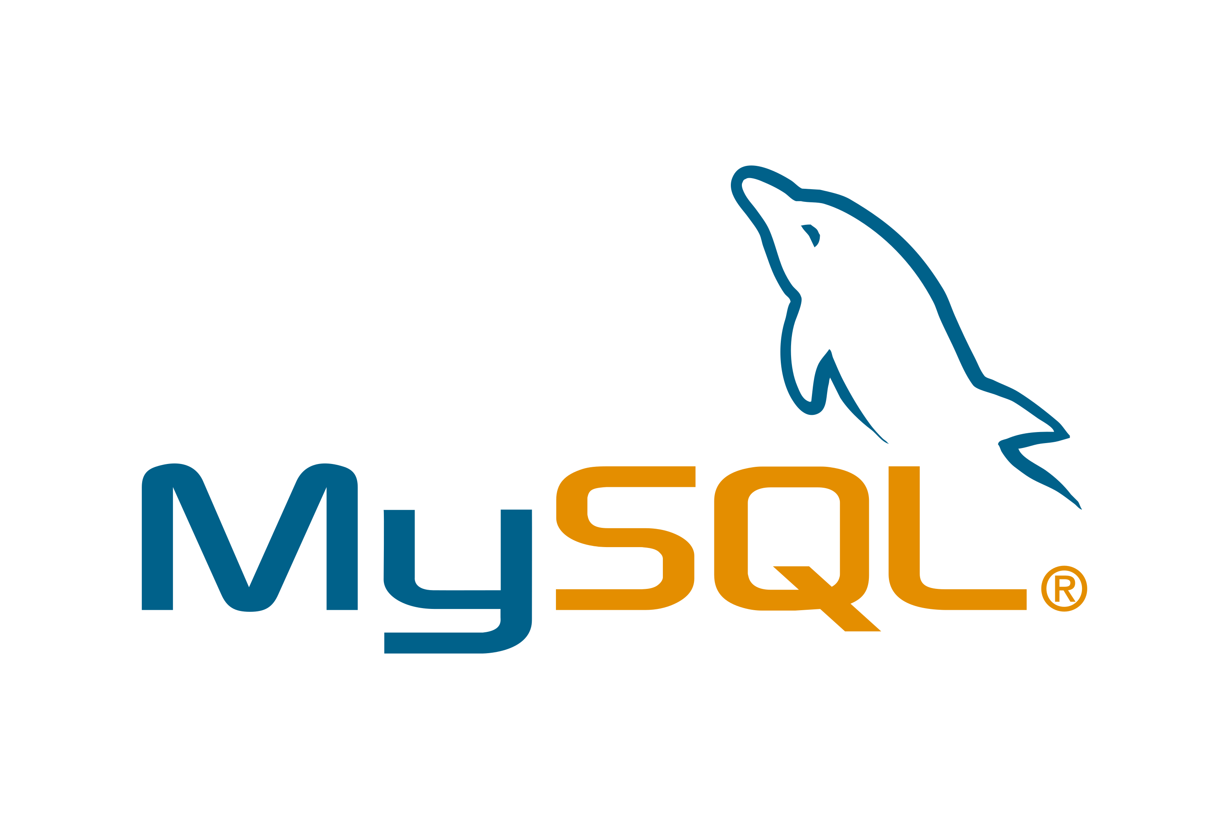




Giuseppe Velocci
Giuseppe Velocci
Backend Developer @ MSC Technology Italia
Backend Developer
MSC Mediterranean Shipping Company
Nov 2021 – Present
Full-Stack Developer
Deltatre
Sep 2020 – Oct 2021
ITS Degree in Integrated backend services
ITS ICT Foundation
Jul 2020
Freelance web Developer
-
Sep 2015 – Nov 2017

Slide 4

What is and why SOLID?
Disclaimer
This presentation is about the SOLID principles of object-oriented programming. For the fundamental state of matter, look at your computer. For other uses, see use Google (it is your best friend)
© Copyright MSC Mediterranean Shipping Company SA

Slide 5


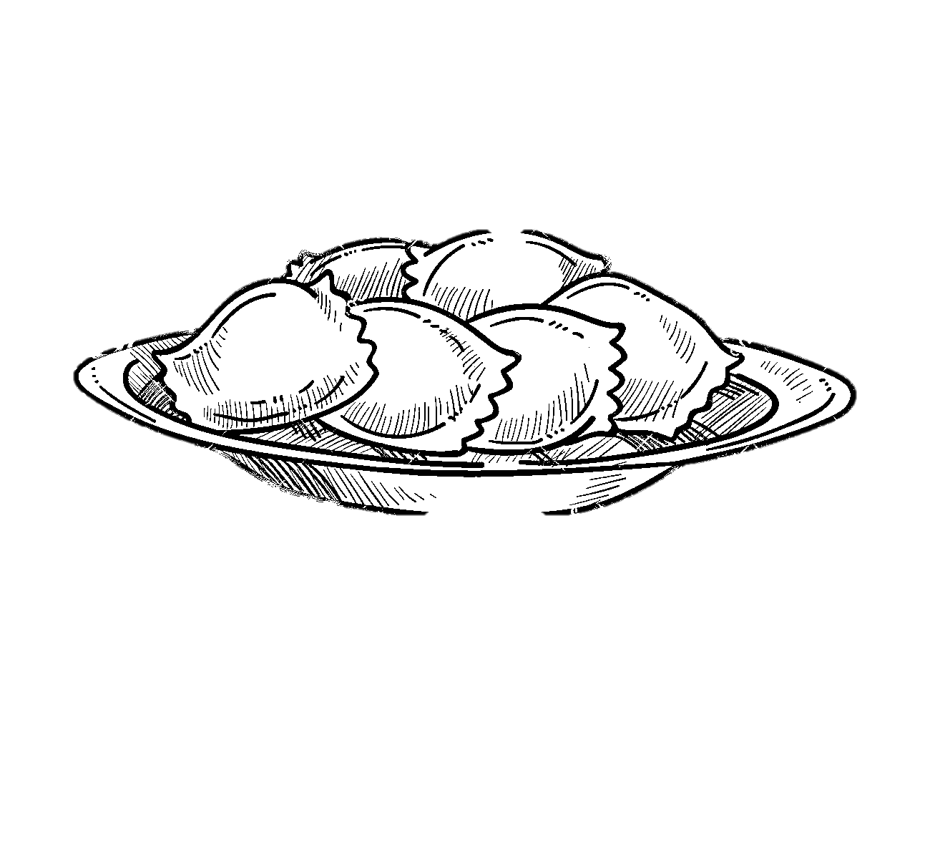

Pasta Coding
Spaghetti
Lasagna
Ravioli
Unstructured and difficult to maintain source code
Object-oriented code written in a procedural style, forsaking polymorphism
Layers and classes are so complicated and tightly coupled that making a change in one layer requires modification in all the others
Well structured classes easy to understand in isolation, but difficult to understand as a whole

Slide 6
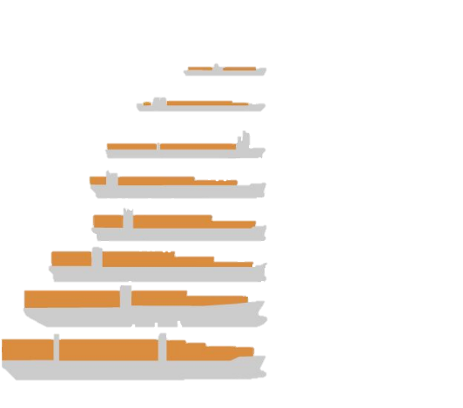
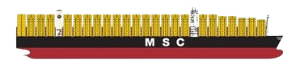
Improve existing code base quality
refactor
[/riːˈfaktə/] verb
_____________________________________________
1. To rewrite existing source code in order to improve its readability, reusability or structure without affecting its meaning or behaviour
2. To trash old code while blaming other developers in order to write brilliant new code that preserves bad performances and old bugs
TEU
800
2.500
3.400
4.500
5.000
8.000
12.500
18.000 23.756
unit test
[/ˈjuːnɪt tèst/] noun
_____________________________________________
1. An automated software testing method by which individual units of source code are tested to determine whether they are fit for use
2. Additional code logic to run on demand that usually requires modifications at each coding iteration

Slide 7

The principles
S
Single Responsibility
O
Open/Closed Principle
L
Liskov’s Substitution
I
Interface Segregation
D
Dependency Inversion
Uncle Bob – Robert C. Martin
Notes:
S -> "There should never be more than one reason for a class to change“ O -> "Software entities ... should be open for extension, but closed for modification"
L -> “Methods and Classes must be able to use objects of derived classes without knowing it“ I -> "Many client-specific interfaces are better than one general-purpose interface"
D -> "Depend upon abstractions, [not] concretions”

Slide 8

Introducing live coding session: Digital factory platform, a SImplifIed overview
Data transformation and enrichment
Booking messages queue
Equipment Activities messages queue - *DCSA standard format
Equipment Activities messages queue
Digital Factory Platform
*DCSA:
Digital Container Shipping Association

Slide 9
Demo
Terminal
Last login: Thurs May 12 12:35:33 on ttys002
giuseppe-vdi: ~ giuseppe$ dotnet restore ./SolidPlayground.csproj
giuseppe-vdi: ~ giuseppe$ dotnet build --configuration Release --no-restore -p:Version=0.1.0 ./SolidPlayground.csproj
giuseppe-vdi: ~ giuseppe$ dotnet run --project ./SolidPlayground.csproj

Slide 10



Samples & Presentation
@
The SOLID Playground sample code and this presentation are available on our GitHub space.
Don’t be shy and start to contribute from today!
https://github.com/msc-technology/solid-playground

Slide 11

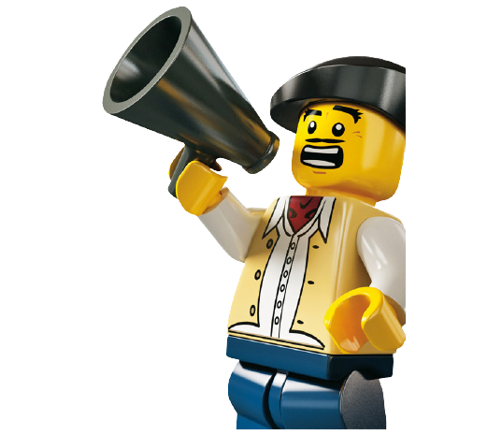
We are looking for talents
The Academy is around the corner Get on board!
https://joblink.allibo.com/ats9/job-offer.aspx?DM=2085&ID=121596 https://www.msc.com/tech-italy

